Slide 1
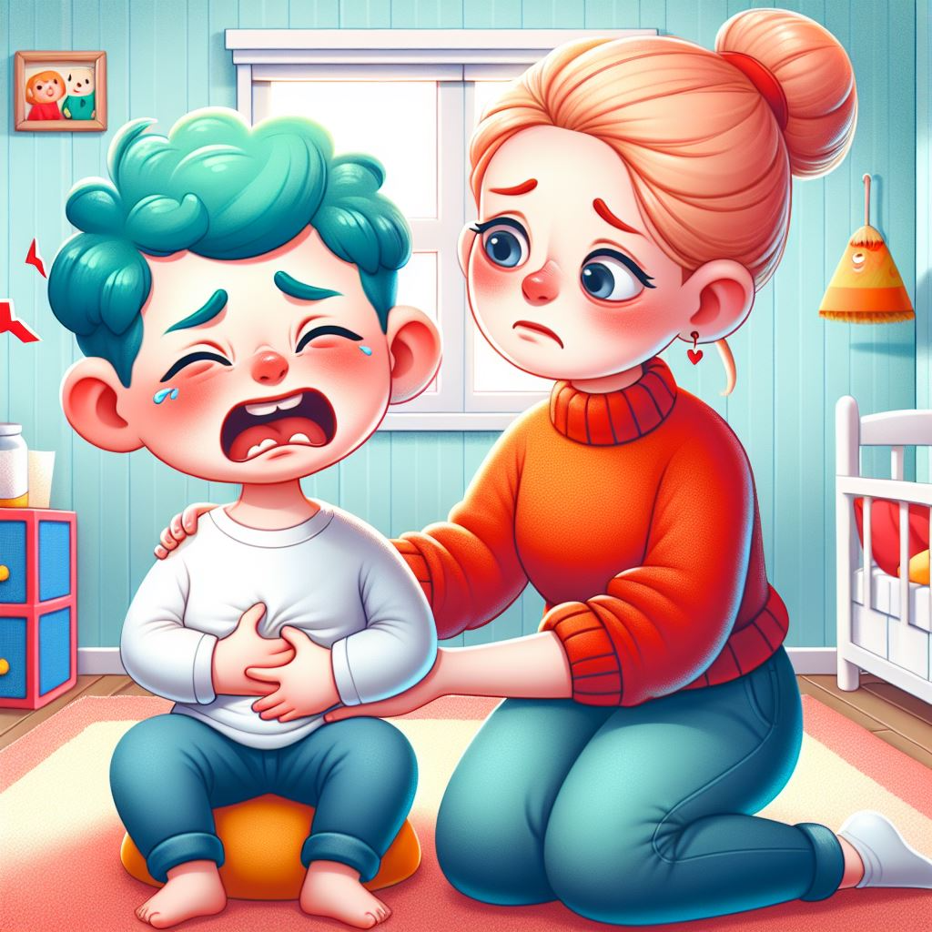
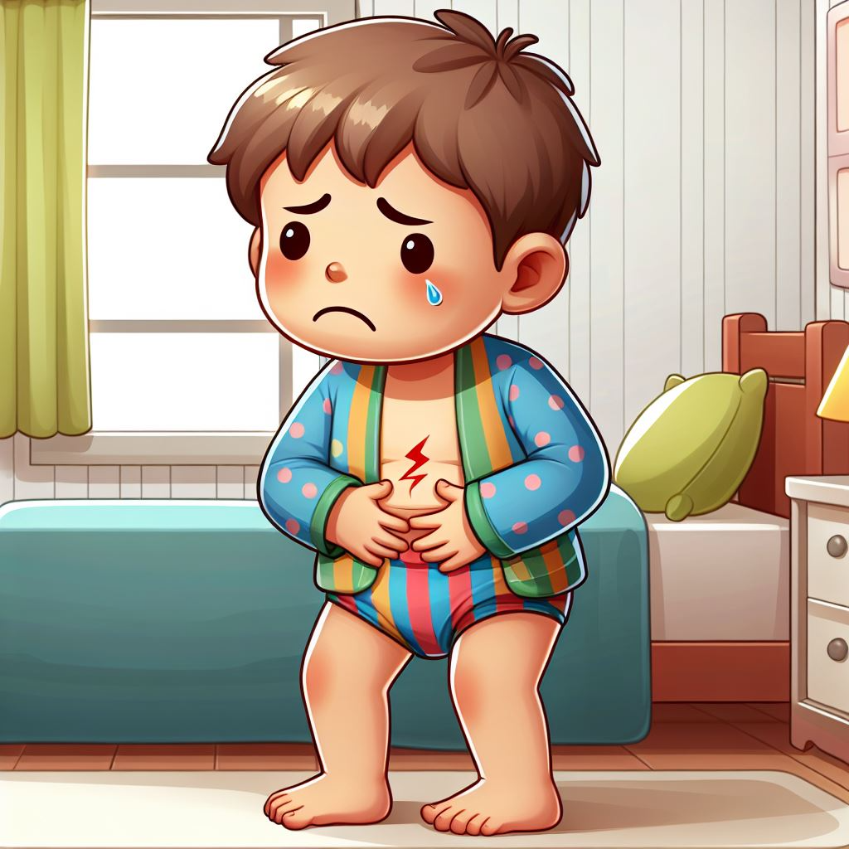
INSPPIRE-2 Winter Newsletter The International Study Group of Pediatric Pancreatitis: In search for a cuRE (INSPPIRE)
Issue 10 March 2025
Our Team: 25 Centers Worldwide
You are helping us to learn more about pancreatitis!
Children with ARP and CP and their families told us that pain and fatigue
are their most bothersome experiences.
Patient and family input to determine experiences and research interests in pediatric pancreatitis: an INSPPIRE-2 study
Cress, et.al. (Pancreas 54(1):p e18-e22, January 2025. | DOI: 10.1097/MPA.0000000000002390).
Pancreatitis can be a challenging condition for both children and their families. The experiences that impact them the most include these top 5:
Pain
(74%)
Tiredness
(35%)
Missing school
and social
Events (33%)
Upset
Stomach
(31%)
Not knowing
when an
attack will occur (28%)
Families and children want researches to learn more about these things to improve their quality of life.
How to prevent an attack (60%)
How pancreatitis affects other parts of the body (58%)
Ways to treat or handle pain (56%)
Cause of pancreatitis (44%)
Healthcare
provider
Families and patients can find out more about pancreatitis using these sources.
Teaching healthcare providers about pancreatitis and how to treat was the 5th most important (39%). More training is needed to help providers understand and manage this condition better.

Slide 2
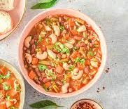
https://medicine.uiowa.edu/pediatrics/research/pediatric-centers-and-programs/insppire-pediatric-pancreatitis-research-project
Your Participation is Important!
Importance of completing follow-up visits:
INSPPIRE-2 is a longitudinal natural history study. This means that we are collecting data over time to see how pancreatitis progresses. Demographic, genetic, environmental, and other risk factors that influence disease progression are collected. These factors change over time just as the severity and frequency of acute pancreatitis attacks, pain, quality of life issues, and progression from acute recurrent pancreatitis (ARP) to chronic pancreatitis (CP) and acquiring exocrine insufficiency or diabetes. Treatments may decrease burdensome symptoms and slow progression. It is essential to collect data on a regular basis so that we don’t miss these important changes. Your time and efforts to attend visits with your healthcare provider and complete questionnaires are greatly appreciated.
The insights gained from this data can inform the development of new treatments, improve diagnostic criteria, and enhance patient care. They are particularly valuable in rare diseases, such as childhood pancreatitis, where little is known about the long-term effects.
What have we learned so far:
We found that genetic mutations and duct blockages are the most common risk factors linked to pediatric pancreatitis. More than 75% of children with ARP or CP have a pancreatitis associated genetic mutation. CFTR gene mutations are common in children with ARP and PRSS1 gene mutations are common in children with CP. Pancreas divisum is the most common obstructive factor in CP. Having a higher triglyceride level can lead to more burdensome pancreatitis attacks.
Site name: University of Iowa Stead Family Children’s Hospital
PI: Dr. Aliye Uc
Research Coordinator: Gretchen Cress, MPH, Rn
Tel: 319-353-4544
In your surveys, you told us that you have frequent pain, hospitalizations, emergency room visits, missed school days, and missed social events. These things make it difficult for children with pancreatitis to take care of themselves and complete their schoolwork. This can sometimes lead to anxiety, depression, and social withdrawal.
Some of the kids in the study had a lower bone mineral density and were shorter than kids without pancreatitis.
We have been looking for ways to help children with pancreatitis deal with pain and to decrease the number of pancreatitis attacks they have. Some things that may help and that we plan to study are cognitive behavioral therapy to help deal with the pain and medications to help decrease the number of pancreatitis attacks.
Your time spent completing the surveys and dedication to the study allowed us to inform other health care providers about pediatric pancreatitis. We are continuing to look for ways to slow down the progression of this disease and improve the quality of life of children with pancreatitis and their families.
Thank you for participating in this largest ever NIH-funded clinical study to better understand how childhood pancreatitis develop and evolve over time. You have made a tremendous impact, and we are eternally grateful for your participation! Going forward, we aim to develop ways to recognize this condition early, treat better and prevent progression to a more advance form.
Marvelous Minestrone
Ingredients:
1 Tbl. Olive or vegetable oil
1 large yellow onion, chopped
4 carrots, peeled, halved lengthwise, sliced
2 celery stalks, halved lengthwise, sliced
3 garlic cloves, finely chopped
2 tsp dried basil
1 16-ounce can diced tomatoes with liquid
10 cups chicken, beef, or vegetable stock
½ bunch kale, chopped
1/3 cup orzo or small pasta
2 cups canned white or kidney beans, drain and rinse
Freshly grated Parmesan cheese
From Healthy Family Recipes for Pancreas Disease, The National Pancreas Foundation
www.pancreasfoundation.org.
Instructions:
Heat pot on stove on medium heat. When hot, add oil, onions, carrots, celery, garlic, and basil. Cook, stirring occasionally until the vegetables begin to soften, about 10 minutes.
Add tomatoes, stock, and kale. Bring to a boil. Turn the heat down to low and cook for 1 hour.
Add the orzo and beans, Cook until orzo is tender, about 12 minutes.
Serve right away, sprinkled with parmesan cheese.
Can be covered and refrigerated up to 3 days.

