Slide 1


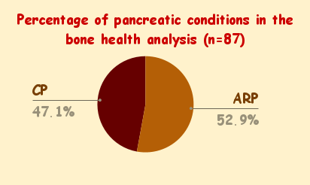
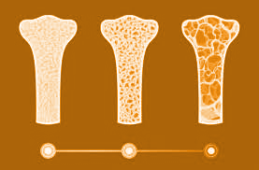

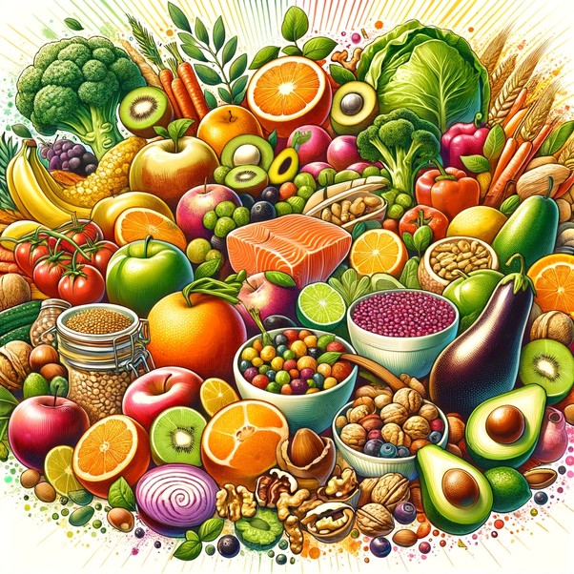
INSPPIRE-2
Summer Newsletter
The International Study Group of Pediatric Pancreatitis: In search for a cuRE (INSPPIRE)
Issue 9 June 2024
Our Team: 25 Centers Worldwide
You are helping us to learn more about pancreatitis!
Children with ARP and CP have lower height and BMD than healthy peers.
Bone health in children with recurrent and chronic pancreatitis: A multi-center cross sectional analysis.
Abu-El-Haija, et.al. (Pancreatology. 2023 Nov ; 23(7): 755-760. https://doi.org/10.1016/j.pan.2023.08.006.
We looked at bone health in 87 children with
ARP or CP. This is what we found:
- Those with ARP or CP had lower height and
bone mineral density (BMD) when compared
to their healthy peers.
- Of the 53 who had Vitamin D information
available, 70% experienced Vitamin D
insufficiency.
How to keep your bones healthy
Tip - Get active!
Physical activity supports bone health. When possible, get active by moving around, participating in physical therapy, and/or exercises that serve your body type and abilities.
Questions for your health care provider:
Ask about Dual Energy Ray Absorptiometry (DEXA) Scanning. It is used to measure the density and strength of bones. INSPPIRE-2 study recommends that children with CP have a DEXA every 2 years if BMD is normal and every year if BMD is abnormal.
Talk about supplements, vitamins and dietary options to ensure nutritional efficiency.
Some examples include vitamins C, D, K.
Consider dietary options that are rich in calcium such as:
Dairy: cheese & milk
Leafy greens: kale, broccoli, cabbage, okra
Fortified foods (added micronutrients):bread, fruit juice, soy milk etc.)
Fish: sardines (young, small pilchards) and pilchards
Tofu and or nuts
Notes:
Information supporting nutritional options for healthy bones: https://www.nhs.uk/live-well/bone-health/food-for-strong-bones/
DEXA recommendations: Ahmed A, Deep A, Kothari DJ, Sheth SG. Bone disease in chronic pancreatitis. World J Clin Cases. 2020 May 6;8(9):1574-1579. doi: 10.12998/wjcc.v8.i9.1574. PMID: 32432135; PMCID: PMC7211537 (https://www.ncbi.nlm.nih.gov/pmc/articles/PMC7211537/#:~:text=European%20societal%20guidelines%20recommend%20that,evidence%20for%20osteopenia%20is%20found.)

Slide 2
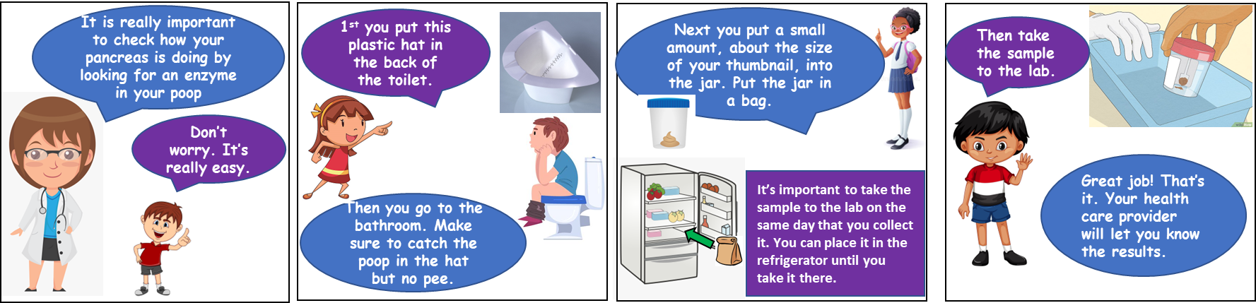
https://medicine.uiowa.edu/pediatrics/research/pediatric-centers-and-programs/insppire-pediatric-pancreatitis-research-project
Kenneth Ng, DO
Pediatric Gastroenterologist
Director of Endoscopy
Medical Director, Pediatric Pancreas Clinic
Co-Medical Director, Pediatric Total Pancreatectomy with Islet Autotransplantation Program
Johns Hopkins Children’s Center
Baltimore, MD
MRCP vs ERCP
There are many types of pancreatic
diseases that pancreatologists deal with.
Pancreatitis (inflammation of the pancreas)
is the most common one. There are various forms of pancreatitis that require different tests and treatments. Some tests have long names that use acronyms which can be difficult to remember. Two that often get confused are MRCP and ERCP. Although they share some similarities, they are both quite different.
MRCP stands for magnetic resonance cholangiopancreatography. It is a form of magnetic resonance imaging or MRI. This is a type of imaging that uses magnet-based technology to view the body in slices. It allows radiologists to see parts of the body with great detail. This is the preferred test to evaluate the pancreas without putting any instrument inside the child The patient will receive contrast or dye through an intravenous (IV) line during the MRI. This will help the radiologist see the organs more clearly. There is no risk of radiation with an MRI which is very important for children. However, it does take a longer time to do the study. It can be hard to do this study on young children because they cannot hold still for a long time. Some children may need medicine to help them to hold still for the test to be performed well. The risks of having an MRI include an allergic reaction to the IV contrast or dye given. MRCP is performed in a large tube. Patients who do not like being in tight closed spaces may not tolerate the study. Lastly since it
uses magnets, patients with any metal in their body should not undergo this study.
ERCP stands for endoscopic retrograde cholangiopancreatography. During this procedure, the patient is given anesthesia through an IV line to fall into a deep sleep. An anesthesiologist will also place a breathing tube (endotracheal tube). Next, the endoscopist (the doctor performing the procedure) puts a long flexible tube-like camera into the patient’s mouth. The camera looks sideways and is connected to a computer. This allows for a real time view of the inside of the food pipe, called esophagus. The tip of the tube is advanced down the esophagus, beyond the stomach, and into the small intestine (called duodenum). The tip is then placed to face a muscular doorway called the major papilla. This is the door to both the pancreatic duct and the common bile duct (roadway towards the liver). One can think of this as the entry way to a house and upon entering one can go up the stairs (toward the liver) or to the first floor (toward the pancreas).
The endoscopist uses tools and will take x-ray pictures to safely evaluate and treat the duct If a problem is found, the endoscopist can manage it during the same procedure. For example, if stones are found in a duct, they can be removed. Then the duct will be cleaned out restoring fluid flow. If the duct is narrowed the endoscopist can use a tool called a balloon dilator to open it also restoring flow. The endoscopist may need to leave a small temporary stent (hollow tube) in the duct to maintain good fluid flow. If this happens, the patient will likely need another ERCP to look at the duct and remove the stent.
Families should be aware of the risks associated with any procedure. ERCP has a low risk for pancreatitis, bleeding, infection, medication reaction, perforation, and cholangitis (inflammation of the bile duct). Doctors and families should always weigh the risks and benefits when deciding what tests should be performed.
Stool Sample Collection
Site name:
PI:
Research coordinator:
Tel:

